Slide 1

JavaScript and jQuery Course
Class 14

Slide 2
Plugins
Extend the functionality of jQuery
Prewritten jQuery code that add features for almost any conceivable task
Some are part of the jQuery Organization
Some are written by the community

Slide 3
Plugins - Types
displaying images
slideshows, carousels, galleries
menus, navigation
tool tips
forms / validation

Slide 4
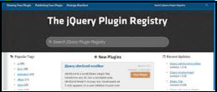
Plugins – Where to find
http://plugins.jquery.com
Many have a demo, sample code, and tutorial

Slide 5
Plugins – Popular

Slide 6
Plugins – How to Add
Download the plugin code
Include the jQuery core library to run
Include the JS file with an HTML script tag
The plugin script tag must appear after the jQuery library script tag

Slide 7
Plugins – How to Add
Some plugins may contain multiple JS files
Make sure that the “.js” file is in the same folder as the html file or that the path is correct if you are using a folder structure

Slide 8

Plugins – How to Add
Plugins commonly come with demo code
Can be customized – variables / methods
Commonly use a JS folder, a CSS folder, and an images folder if needed

Slide 9
jQuery UI (User Interface)
Extends the jQuery library
Provides themes, widgets, interactions, and effects
The core jQuery UI component (library) is always required in addition to the jQuery code for the components

Slide 10
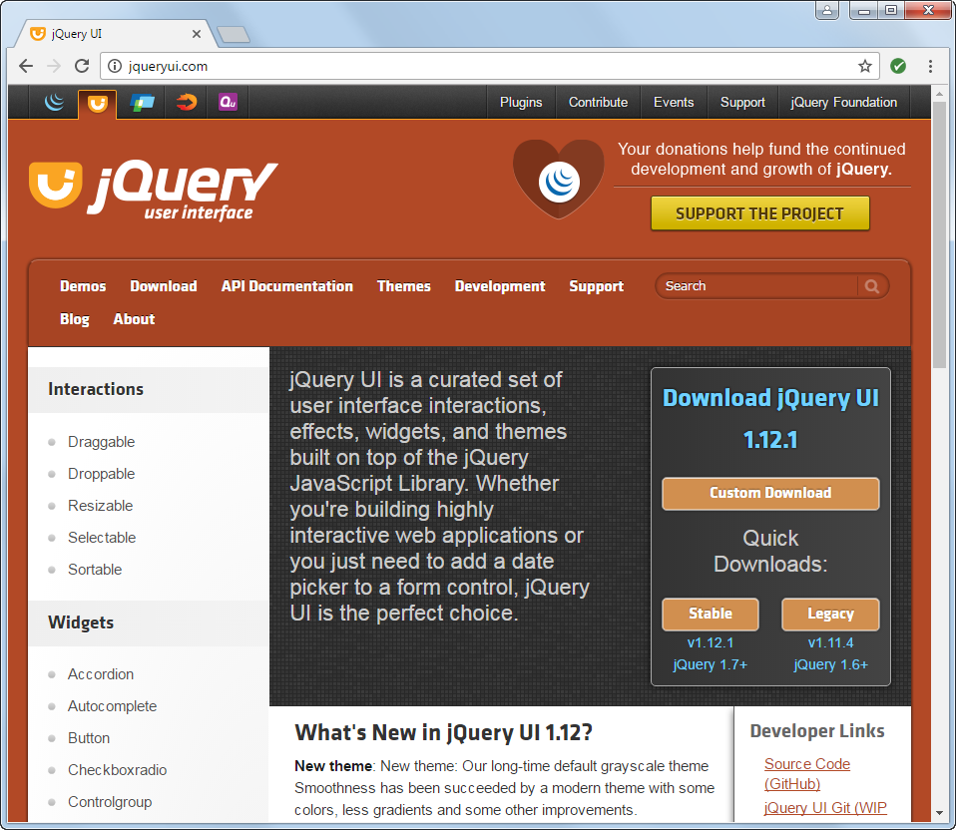
jQuery UI
http://jqueryui.com
Many have a demo, sample code, and tutorial

Slide 11
jQuery UI – Types of Components
Themes
- CSS themes for the components
Widgets - accordions, tabs, slider, date picker
- self contained
Interactions - drag, drop, resize, sort
- can be applied to any HTML element
Effects - color animations, transitions, bounce, explode, fade, slide
- can be used with a widget or interaction

Slide 12
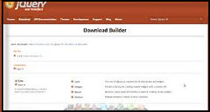
jQuery UI – How to use
jqueryui.com/download
Unlike downloading a plugin, you must first ‘build’ the jQuery UI download at the Download Builder page

Slide 13
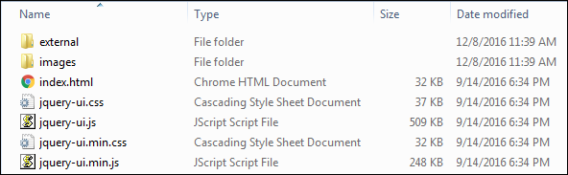
jQuery UI – Download Example

Slide 14
jQuery UI – Code Example
<link rel="stylesheet"
href="/jquery-ui-1.12.1/jquery-ui.min.css">
<script src="http://code.jquery.com/jquery-3.1.1.min.js">
</script>
<script src="/jquery-ui-1.12.1/jquery-ui.min.js">
</script>
<script>
$(document).ready(function(){
$("selector").UI_method({
// option settings
});
});
</script>

Slide 15
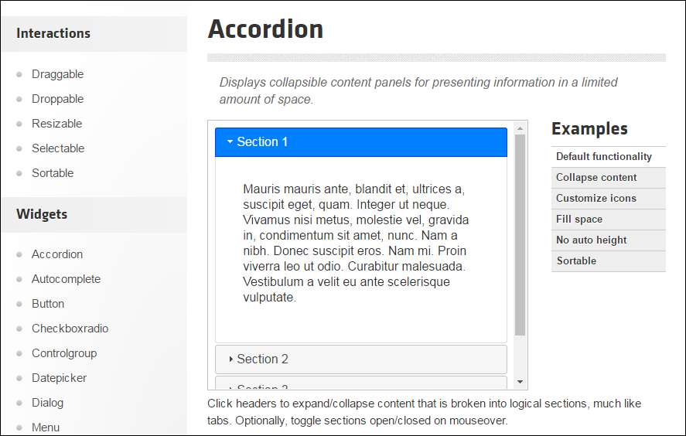
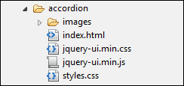
jQuery UI – Accordion Example
$(document).ready(function(){
$("selector").UI_method({
// option settings
});
});

Slide 16
jQuery UI – Accordion Example
$(document).ready(function(){
$(“#accordion").accordion({
// option settings
});
});

Slide 17
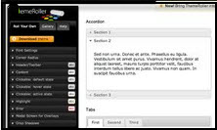
jQuery UI ThemeRoller
http://jqueryui.com/themeroller/

Slide 18
jQuery UI ThemeRoller
Powerful theming engine
Create a theme for your website
Select different colors, fonts, drop shadows, etc. to match your website
Use 24 preset themes

